Slide 1
T-Project preparation material

Slide 2
Revision history
Version | Date | Remark
V1 | 2/24 | 1.Fii’s relationship with VN factory (p.34) 2.Quality inspection frequency (p.24) 3.Inventory management system (p.39) 4.ESD protection wearing picture (p.45) 5.RMA process (p.46)
V2 | 2/25 | 1.Environmental management manual(p.4) 2.Production facility management inspection frequency. (p.43) Ps. The appendix is under checking as it’s internal document 3.Production Equipment List (p.26)

Slide 3
Management system

Slide 4


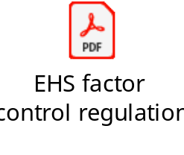
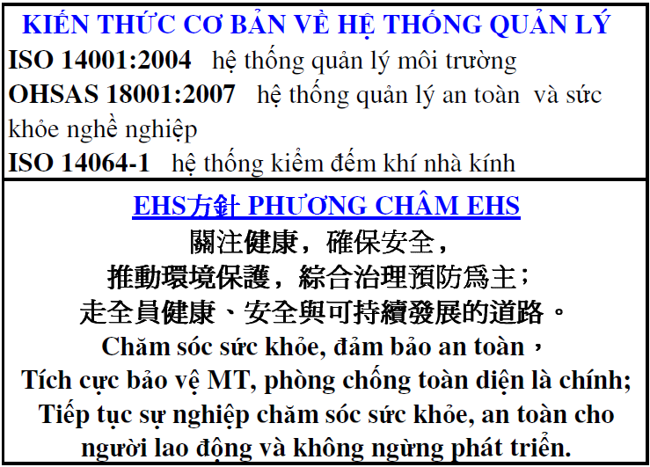
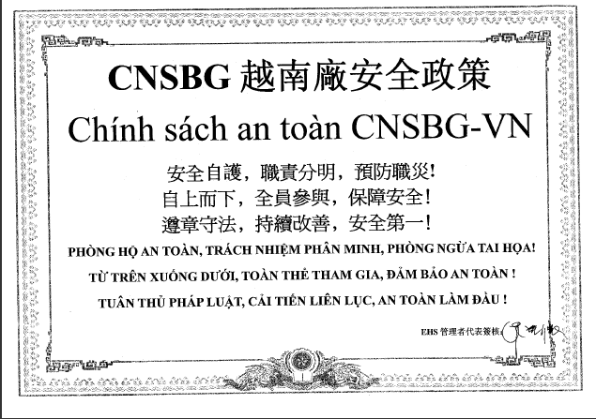
Environment Management System
Environment management certificate ISO14001
Environmental management manual
Environmental management policy
Translation: Pay attention to the health and safety. Advance the environment management and focus on the governance and prevention. Move towards the target of safe, healthy and sustainable development.

Slide 5
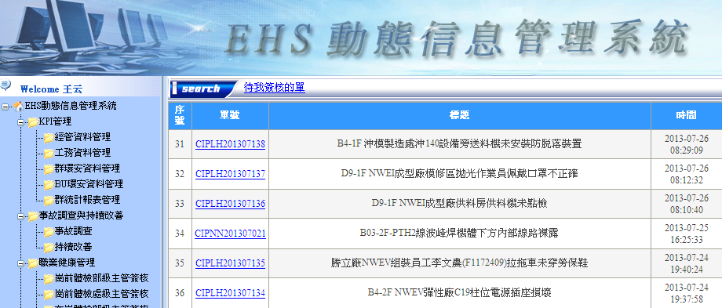
Procedures to identify environmental aspects
-Management System
1. EHS improvement system
Any accident, injury investigation and improvement is followed up by this system﹔and now the Occupational health management function is going to inject into the system.
5

Slide 6

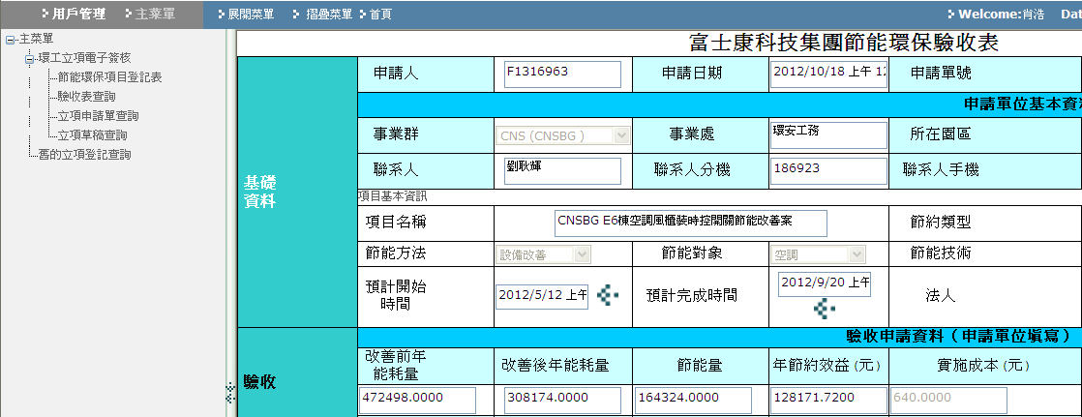
Procedures to identify environmental aspects
-Management System
2. Energy saving apply system
Any energy saving project can be applied to verify on the system which established by foxconn Energy Saving Committee.
6

Slide 7
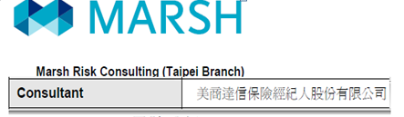
Procedures to identify environmental aspects
-Management System
3. Risk management (third party consultant)
4. For continuous improvement, Foxconn had engaged a third party to conduct a internal risk assessment annually.
7

Slide 8
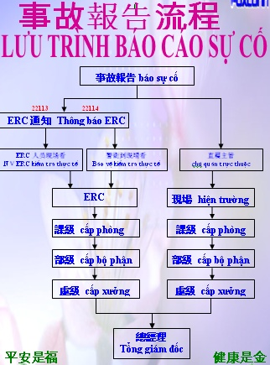
Procedures to identify environmental aspects
-Management System
5. Emergency
Foxconn VN has established campus ERC and BU ERC, for all emergency unusual situation response.
CNSBG emergency policy:2 lines escalate. one is EHS system, another is the incident department. from down to top until General Manager.
Emergency
incident
Automatic
Notification
system
Emergency response
organization
(ERO)
22114/22113
Emergency Response Center ERC
Directing dept manager
Directing officer
Safety auditor
Account
Hospital
Human Resource
8

Slide 9
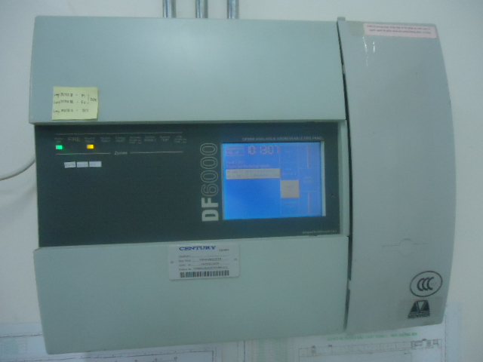
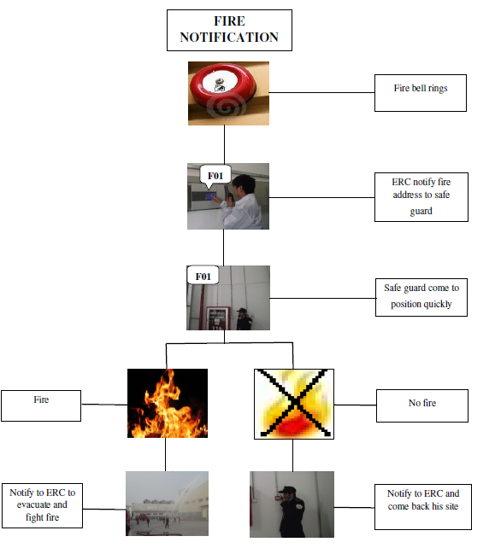
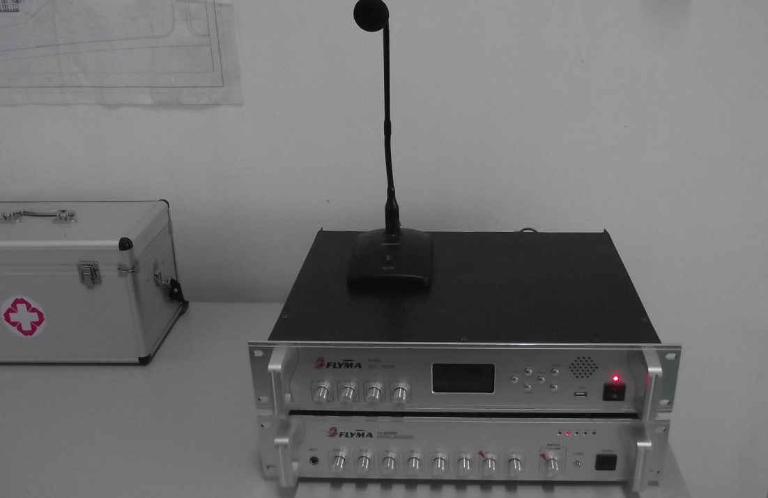
Examples of activities
-Health & Safety
1.Fire prevention and fighting system
1.1. Fire alarm system is covered all buildings.
1.2. ERC is ready for any emergency.
fire alarm system
Fire report procedure
Broadcast system
9

Slide 10
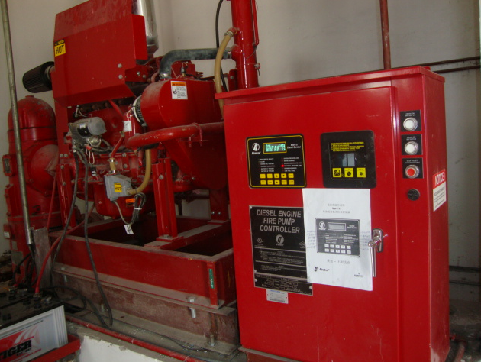
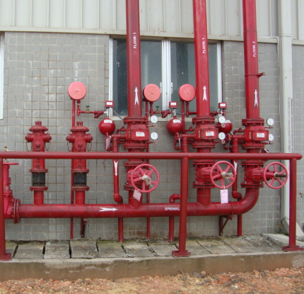
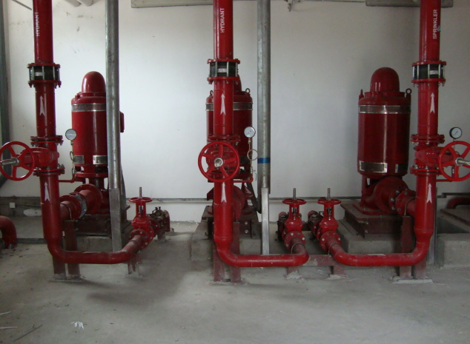
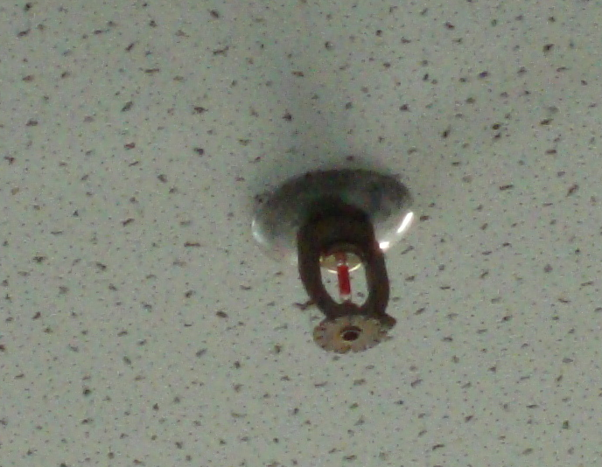
Examples of activities
-Health & Safety
1.Fire prevention and fighting system
1.3 The factory full coverage automatic sprinkler system and fire hydrant system
Spray reserve diesel oil pump: Lose electrical power to switch over automatically
Sprinkler systems
main pump system
Sprinkler
10

Slide 11
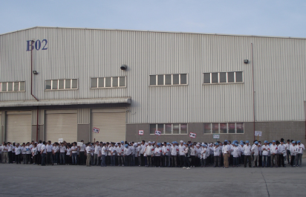
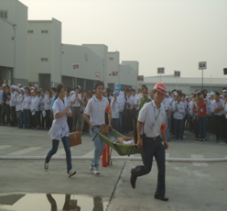
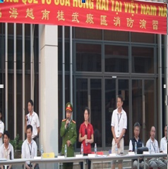
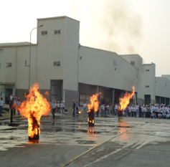
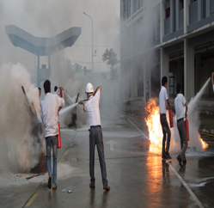
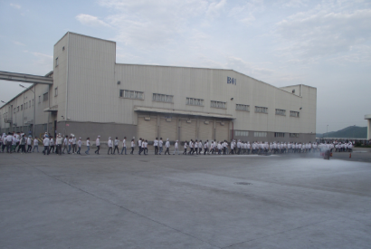
Examples of activities
-Health & Safety
2. Fire drill (2 times/year): Implement semiannual emergency drill to test and improve emergency reporting, fire fighting skill, evacuation activities and First aid.
2021/2/25
11

Slide 12
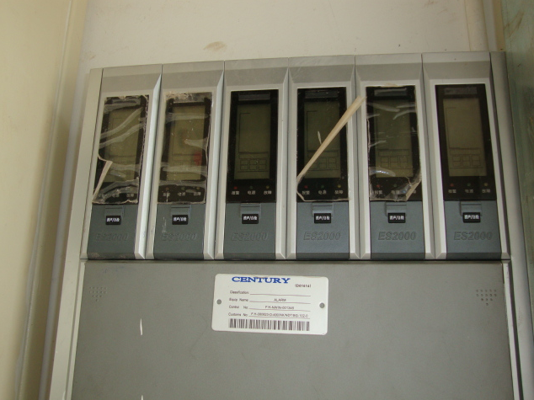
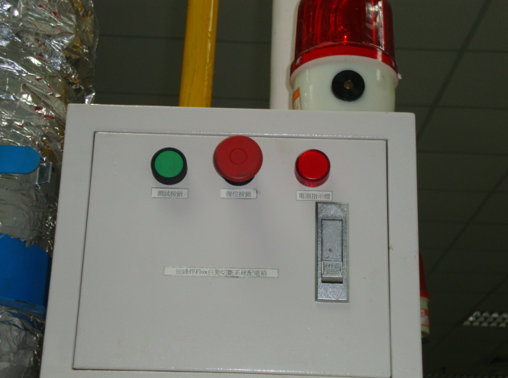
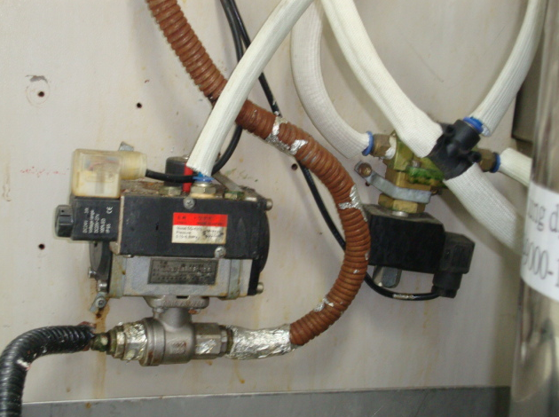
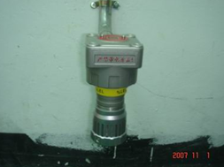
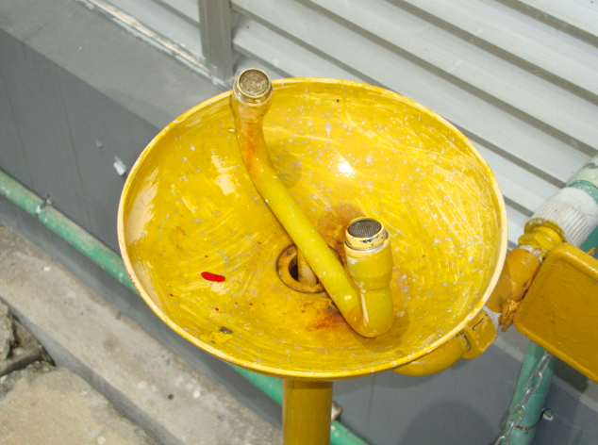
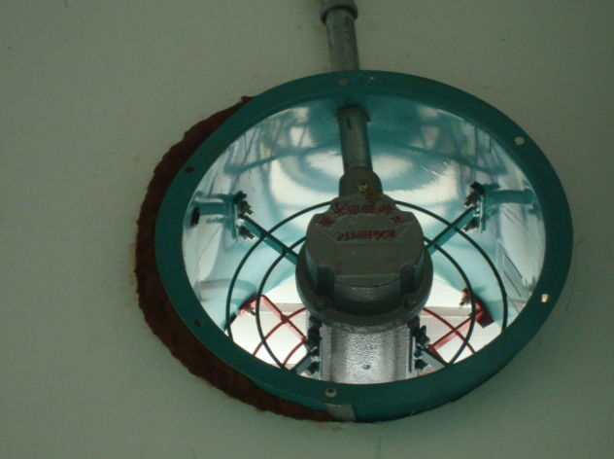
Examples of activities
-Health & Safety
3.Chemical storage& Using:
VOCs alarm system is fixed in special area,such as:
chemical storage, mould cleaning room, solder machine, ....
VOC alarm system
Wave solder Warning system
Wave solder Emergency shut down system
VOC detector
Eyes washing device

Slide 13
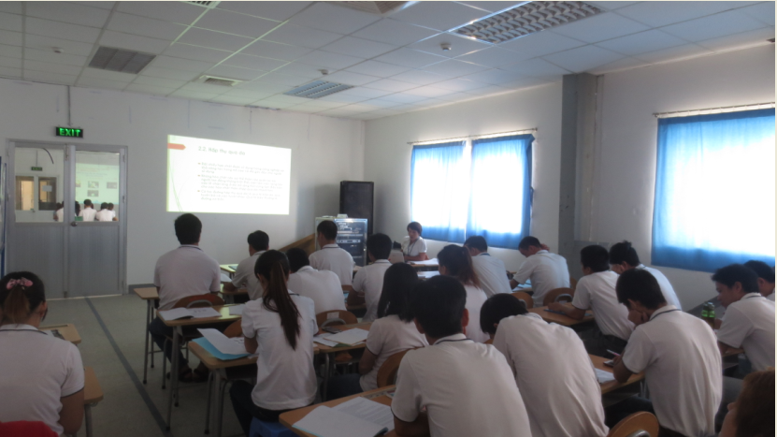
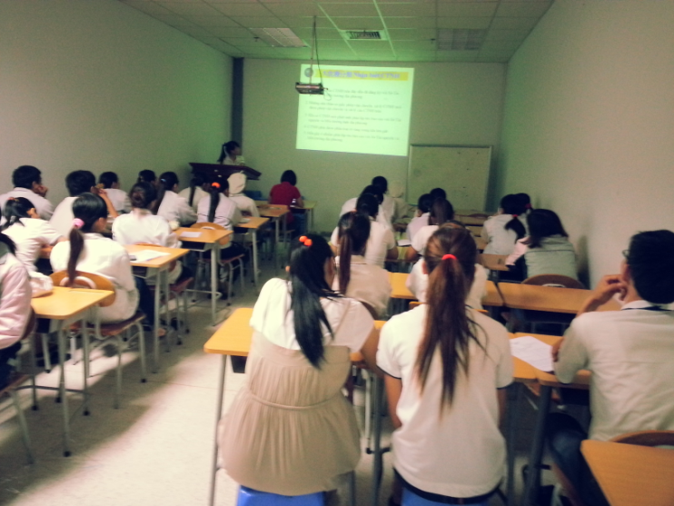
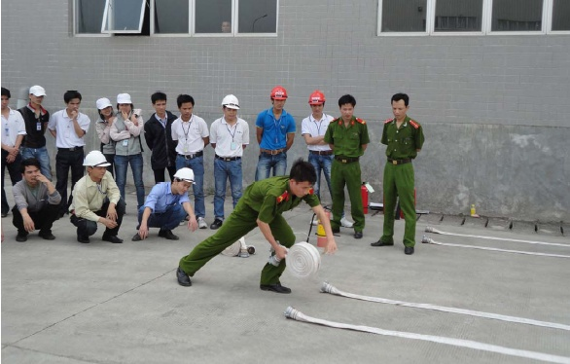
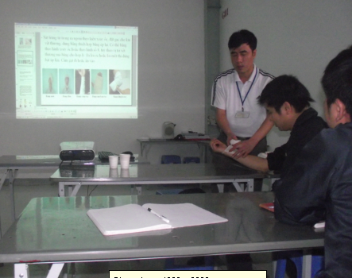
Examples of activities
-Health & Safety
4.Safety skill training
4.1 fire prevention and fighting ,first- aid, industrial safety and hygiene,
supervise to execute work… yearly is carried out.
Chemical safety training
Safety and hygiene traning (internal_)
ERO Fire fighting skill training
First- aid training
2021/2/25

Slide 14
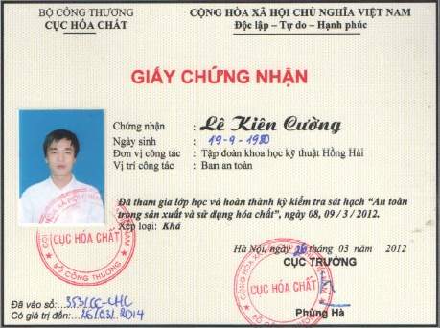
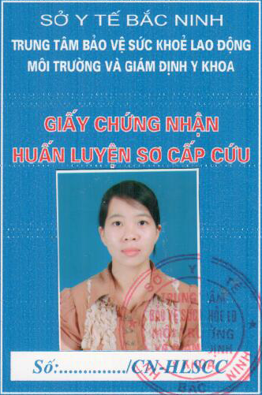
Examples of activities
-Health & Safety
4.Safety skill training
4.2 chemical, radiation, forklift operator need to get the certification from government training department.
Chemical Certificate
First aid Certificate
2021/2/25

Slide 15
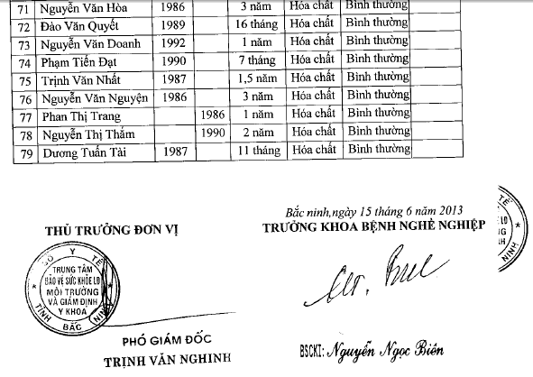
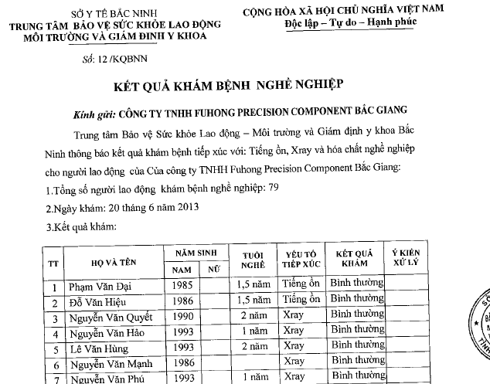
Examples of activities
-Health & Safety
5. Occupational physical examination
5.1 All occupational position, such as X-Ray, Chemical operators have 2tims physical examination per year for according the local law
2021/2/25

Slide 16
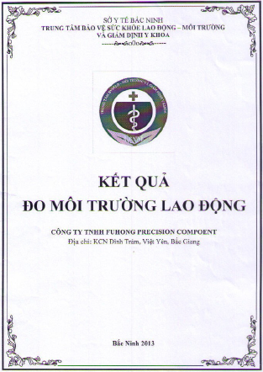
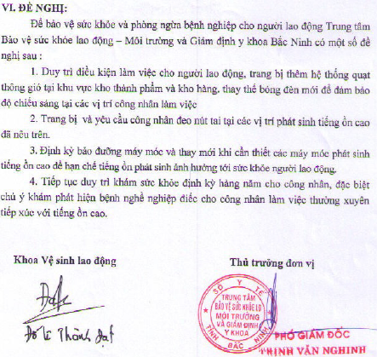
Examples of activities
-Health & Safety
6.working condition monitoring
6.1 Arranged yearly third party to monitor and ensure workshop hygiene met the require standards.
6.2.The items measurement include: humidity, wind speed, noisy, dust, waste water, land, noxious gas ( CO, SO2,NO2,H2S).
The result of measurement in 2013 of FuHong
2021/2/25

Slide 17
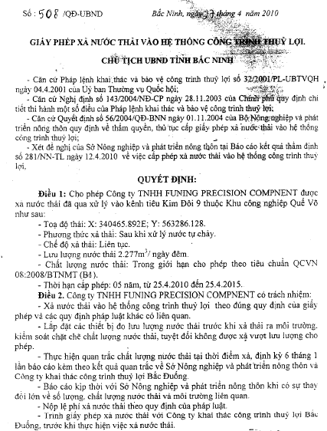
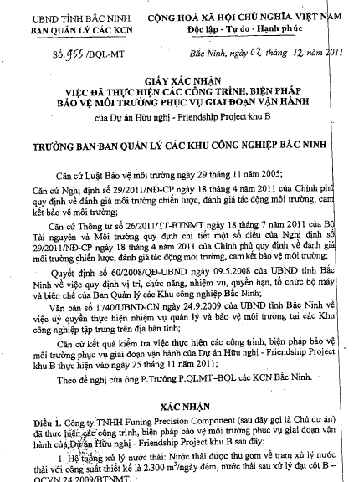
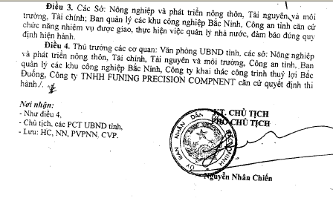
Examples of activities
-Environment & Energy management
1. Environmental permit
1. VN Government had granted the permit of environmental and discharging
2021/2/25
17

Slide 18
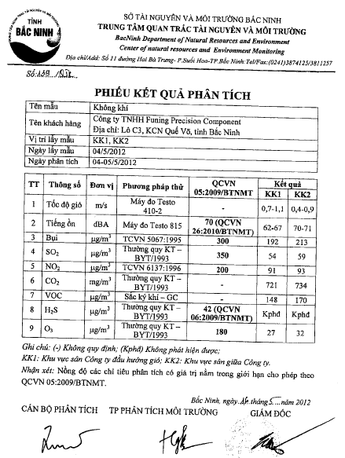
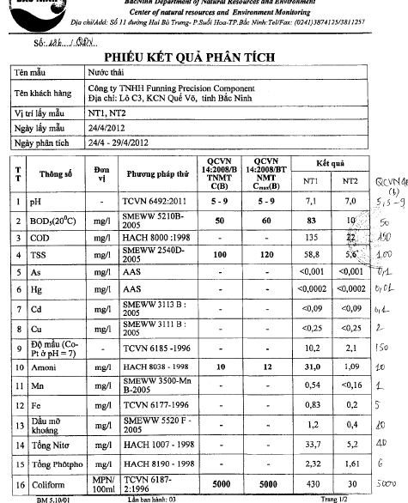
Examples of activities
-Environment & Energy management
2. Environmental Monitoring
Survey by local government Environment Department : Twice/year
Compliant to Vietnamese government regulation/standards
Result of analysis of waste water
Result of analysis of air
2021/2/25
2021/2/25
18

Slide 19
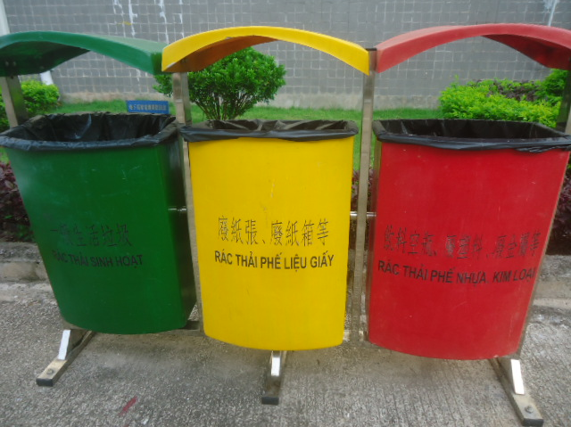
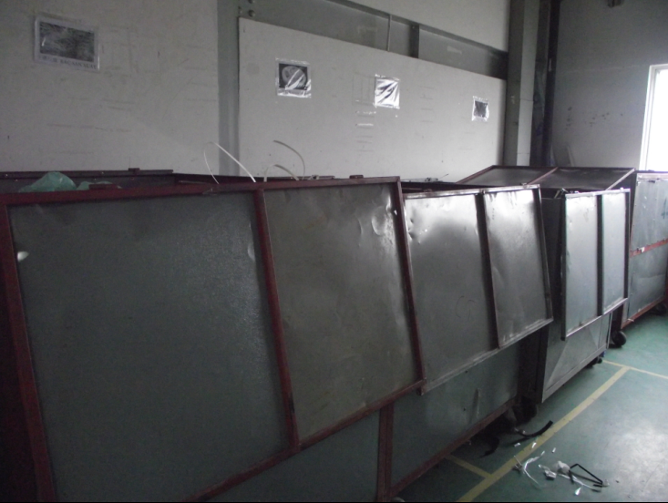
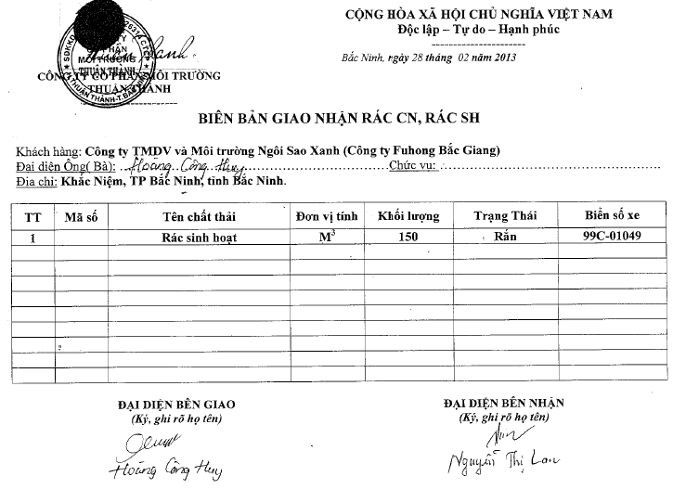
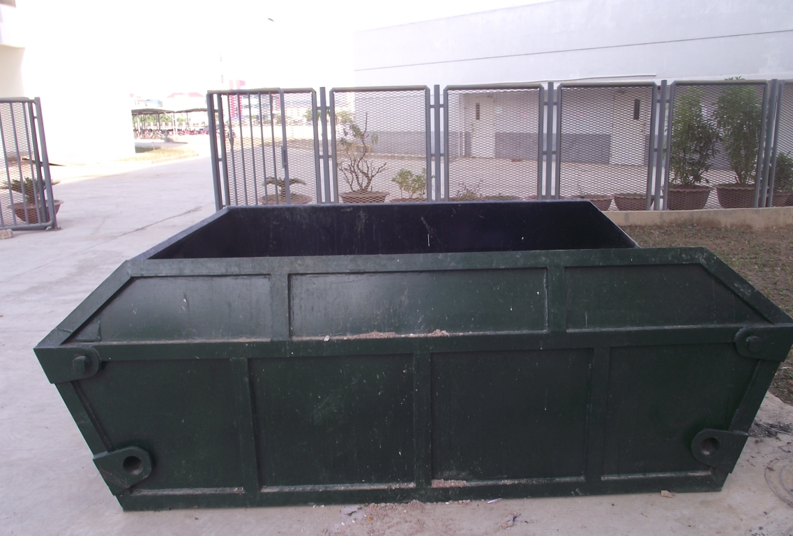
Examples of activities
-Environment & Energy management
4. General Waste treatment
Living wastes and production wastes meets the principle of reduce, reuse and recycle (e.g. reuse cartons and reel trays, etc.)
Living waste classify for “3R”
Production waste are classified to chest for “3R”
Living waste treatment record
Living waste collection tank
2021/2/25

Slide 20
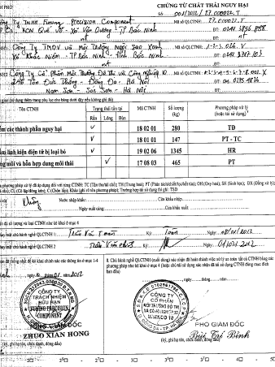
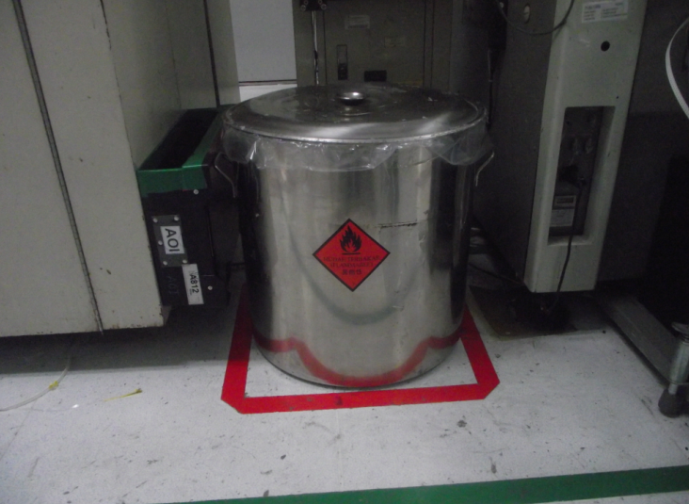
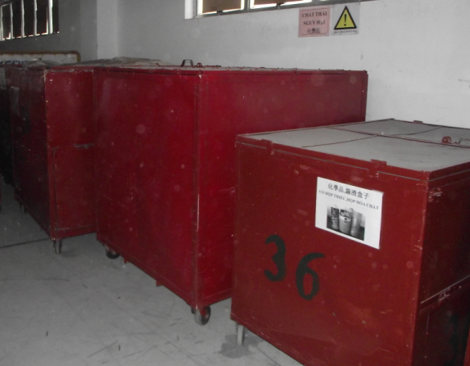
Examples of activities
-Environment & Energy management
4. Hazardous Waste treatment
Hazardous substances are strictly controlled to ensure safe storage, transfer, use and disposal
hazardous waste collection tank in workshop
hazardous waste classify chest for transfer
Hazardous waste transfer invoice
2021/2/25

Slide 21
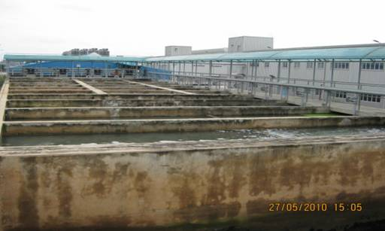
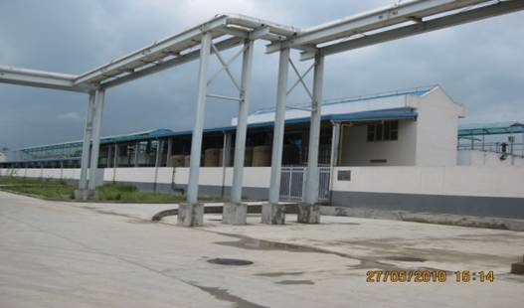

Examples of activities
-Environment & Energy management
5. Waste water treatment
The factory has no industrial waste water.
After treatment the waste water will re- use for toilets
Waste water treatment station
Biology tank discharge
Discharge tank

Slide 22
Examples of activities
-Environment & Energy management
6. Carbon Disclosure Project
Foxconn has conduct Carbon Disclosure Project from 2010;
(Report name is Hon Hai Precision Industry Co. LTD including CNSBG);
CNSBG LH, SJ, ZS, HZ and VN sites successfully awarded with ISO14064-1 certificates since 2012.
Emission reduction performance: CNSBG had reduced 8,584,404 KG CO₂e emission and 167 KG CO₂e emission per person in 2012;
Emission reduction target: 6.5% emission reduction from last year;
2012 GHG emissions data are below:

Slide 23




Examples of activities
-Environment & Energy management
7.Energy saving improvement case
Case 1: waste water reuse system, waste water is 100% reuse to toilet, saving 750,000,000 VND per year
Case 2: Condensed water outlet to Vacuum pump, 102,996,300 VND/year saving
Planning case 1: wave solder nitrogen protection process, estimate saving 70% of tin and flux
Planning case 2: Utilized electro-analysis technique to replace the chemical to clear the air-condition scale
23

Slide 24





Quality Management System
Quality management certificate
  TL9000
  ISO9001
Quality goals, performance indicators, performance management data
  Please refer to the manual
Internal audit plan, results, and corrective action data
  The audit is conducted every 6 months by team comprised of internal professionals
  Please refer to the attachment

Slide 25
Production and Inspection

Slide 26





Production Management
Production equipment (Take 1 SI line for a similar product for example)
SMT equipment list
4K TV*1
4K capture card*1
Spectrum
Acoustic Chamber

Slide 27







































Production consignment contract (OTT experiences)
IPTV / OTT Solutions
System Partners
Customers
Content Partners
Not only box, but also OTT system/Content
Hybrid OTT
Realtek / Broadcom
Standard OTT
Amlogic / Synaptics
Portable OTT
Amoglic / Synaptics
AI Speaker
Amoglic / Synaptics

Slide 28
Test
A
BT
Calibration
PT
Housing
Assembly
FT1
FT2
B
Connect to DUT
Check MFG FW
Check USB2.0 link speed
BT Calibration
Write BT Mac and Configuration (eFuse)
Write SN
Connect to DUT
Check Ethernet LED
Check MFG FW
Check Total Memory
Check USB3.0 link speed
Check HPD
Check CEC
Play Video (H265/VP9)
Play Audio (MP4)
Check AUXIN plug
Check MICIN plug
Push and write initImage
Write ETH/BT MAC
Check BT MAC (flash/efuse)
Check Ethernet CRC &Throughput
Erase data and reboot
Connect to DUT
Check IR Remote UP Key
Check USB2.0 R/W
Check LED (white , off)
Check Front Panel buttons
Set 4KP60 Resolution
Check 4K TV
Play 4KP60 Video
Check HDMI 4KP60 Resolution/FPS
Connect to DUT
Check AUXIN Record
Check AUXIN Play
Check MICIN Record
Check MICIN Play
Check FFV Record
Check FFV Play (all or single )
Check Loop Back Record
Check Loop Back Play
Burn in (5%)
FT3
RC
RC1
LINK
RC2
B
Plug-in USB
Scan QR Code
Link Sequency
SN
Plug-in USB
Scan QR Code
Connect to DUT
Check BT Scan
Check BT Paring
Check BT RSSI
Connect to DUT
Check SN
Check USB3.0 R/W
Upgrade FW
28

Slide 29
Organization and personnel
Please refer to the other RFP documents for the technical support.
Below is the working experience(unit:yr) for SW and HW
SW
Name | Job | Years of working experience
Jacky Chiang | SW Manager | 19
Kerwin Chen | SW Lead | 18
River Wong | Android BSP – Audio HAL/drivers, System Integration | 18
Jim Chen | Android BSP – BT, System Integration | 15
Jason Ling | Android BSP – xTS | 12
Jerry Lin | Android BSP – OTA, Manufacturing Test | 15
Bcan Yeh | Android BSP – Diagnostic, System Integration | 14
Sam Yang | Android BSP – I/O Interface Drivers, System Integration | 4
Peter Chen | Android BSP – Power Management | 3
Brent Choi | Android BSP – FAE | 1
HW
Name | Job | Years of working experience
Sean Chiang | HW Manager | 19
Tom Lee | HW Lead | 20
Fu-Chiang Yang | HW Baseband - Audio, Video, Thermal, Power system, RCU | 14
Catherine Chen | HW RF - BT, ANT, BQB certification | 6

Slide 30
Spare parts management
Please refer to the other RFP documents

Slide 31
Production Control

Slide 32
Production Subject-domestic and overseas production sites
Houston, TX
ATO, North America Regional DF Site
Czech Republic
Enclosure, ATO, EU Regional DF Site
Hungary
CTO,ATO, EU Regional DF Site
Bac Ning/Bac Giang, Vietnam
PCBA, BOX Build
Chongqing, China
PCBA, BOX Build
San Jose, CA
NPI, Engineering Service, PCBA & BOX Build
Slovakia
PCBA, BOX Build
Hang Zhou, China
PCBA, BOX Build
Song Jiang, China
Enclosure, B/P, BOX Build, NPI,
JDM/ODM Design
n
n
n
Santa Clara, CA
NPI, NA Hub, Engineering Service, Enclosure
n
n
TuCheng/HsinChu,
Taiwan
Engineering Service
JDM/ODM Design
n
Chennai, India
Enclosure
Juarez, Mexico
PCBA, DF
Long Hua, China
NPI,Repair, Engineering
Service, PCBA, Enclosure,
BOX Build, B/P
JDM/ODM Design
Manus, Brazil
PCBA, BOX Build
n
Research & Development
Guanlan, China
ATO, Asia / China Regional DF Site
Mass Production Facilities
Nanning, China
NPI,PCBA,Enclosure,Box Build
NPI,Repair, Engineering Service,
JDM/ODM Design
Proposed PCBA Mfg node
Notes:
Manus – Box Build
Sylovras… - PCBA / Box Build

Slide 33

Production Subject
T-project will be Direct production with factory in Vietnam
Factory Name: Funing Precision Component Co.,Ltd

Slide 34

Production Subject
Funing Precision Component Co., Ltd. is one of Foxconn Industrial Internet(Fii) subsidiaries.
Please refer to the attached financial report on page 112 as appendix.

Slide 35

Parts sourcing-import inspection

Slide 36

Parts sourcing-import inspection

Slide 37

Process management-product quality assurance flow

Slide 38

Process management-Shop floor integrated system

Slide 39




Inventory management
Whether the manufacturer has an inventory management system
  Yes. The SAP is adopted to manage the inventory.
  Fii also has storage regulation. The attachment serves as appendix.
Manufacturer's parts inventory ratio standard and holding status
  Fii adopts the JIT model for materials used on production due to the location convenience
  The inventory holding for unexpected demand will be solved by strategy procurement for the materials which could be further discussed with customer.
Production company's material warehouse management status
  Please refer to the attachment for temperature/ humidity and the vacuum packing regulation.

Slide 40
Long Delivery Parts
Please refer to the other RFP documents for the core parts.

Slide 41

Production Area and the mode of transport

Slide 42
Production Management

Slide 43

Production facility management
Whether there is a facility inspection standard for each process
  Yes.
Whether periodic facility inspection is conducted
  Yes. Weekly, monthly, quarterly, semi-annually, annually
Whether the period of facility inspection is carried out on a monthly basis
  Yes.
Whether the production line and workbench are grounded
  Yes.
Please refer to the attachment as appendix

Slide 44
Production and defect management
Whether to record defects by process
  Yes
Whether to manage statistics by lot or periodically
  Yes
Periodic (at least monthly) failure cause analysis
  Yes
Whether improvement measures are established and implemented
  Yes
Please refer to the attachment as appendix

Slide 45

Worker activity
Whether to wear a uniform
  Yes
Whether to wear Rubber shoes
  Yes
Whether to wear an electrostatic bracelet
  Yes
Maintaining the cleanliness of the workstation and wearing safety tools for production-based equipment
  Yes
Please refer to the attachment as appendix

Slide 46

RMA Process
Customer
ALT
Foxconn Industrial Internet (Fii)

